Slide 1
Pathogen Variants and Evolutionary Theory
Theory Module
Slides from Edyth Parker

Slide 2
Outline
Evolution across scales
Different types of mutations
Evolution within and between hosts

Slide 3
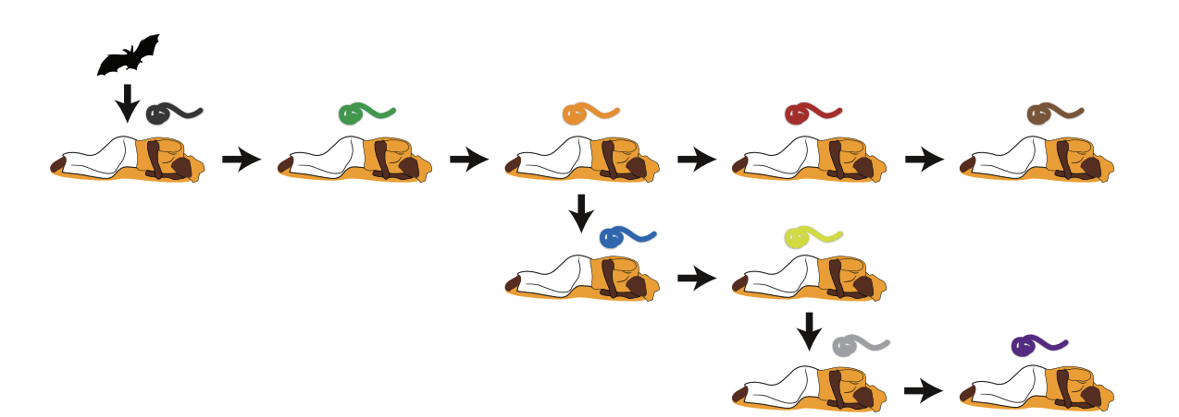
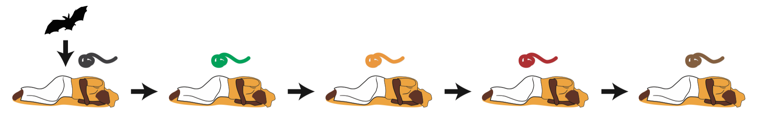
The virus evolves as it spreads between hosts
Time

Slide 4
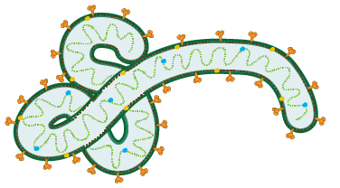
Mutations accumulate in the viral genome
ATGCAGCTAGCTGATGCTGACTGACTGACTG

Slide 5
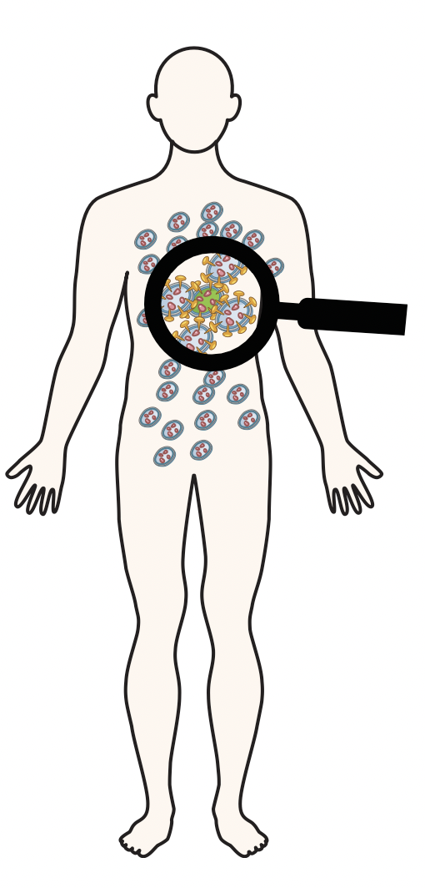
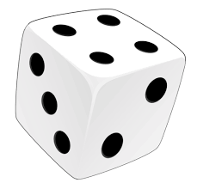
Evolutionary processes play out across multiple scales
Within hosts
Short term evolution
Notes:
Evolutionary processes happen at different scales
Across time, space, hosts (within and between hosts)

Slide 6
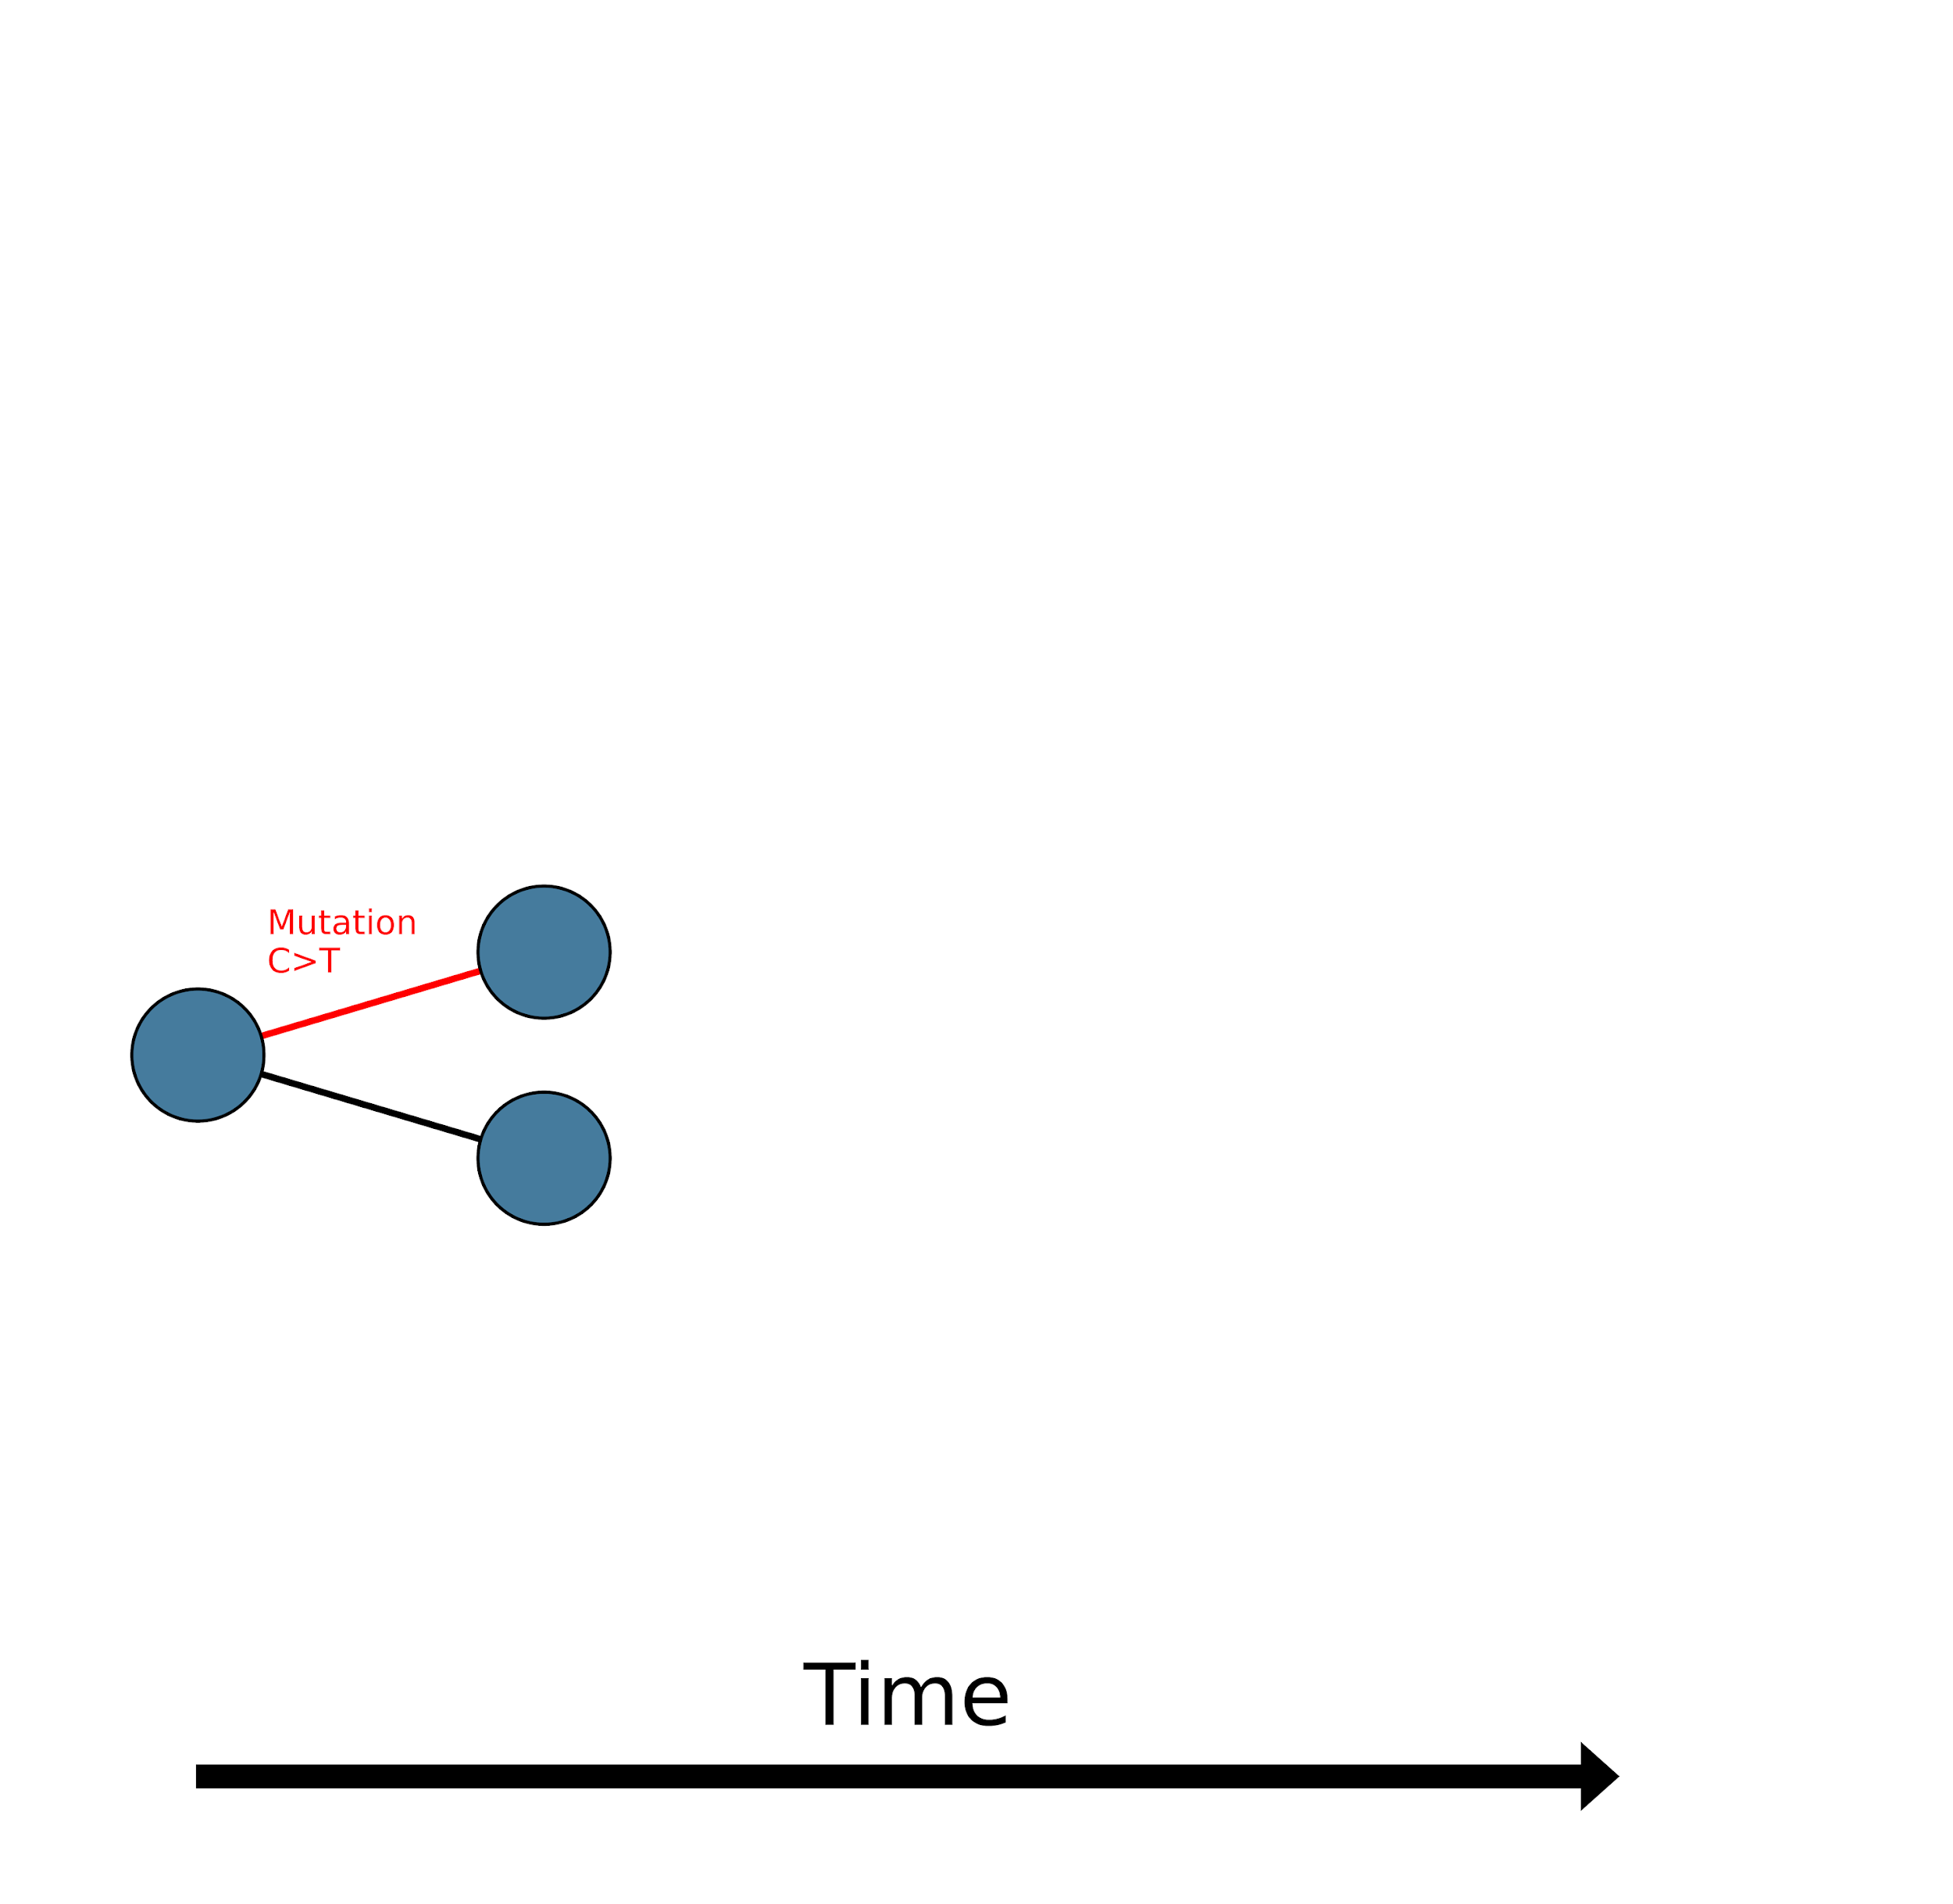
Evolutionary processes play out across multiple scales
Within hosts
Between hosts
Short term evolution
Longer term evolution
Notes:
Evolutionary processes happen at different scales
Across time, space, hosts (within and between hosts)

Slide 7
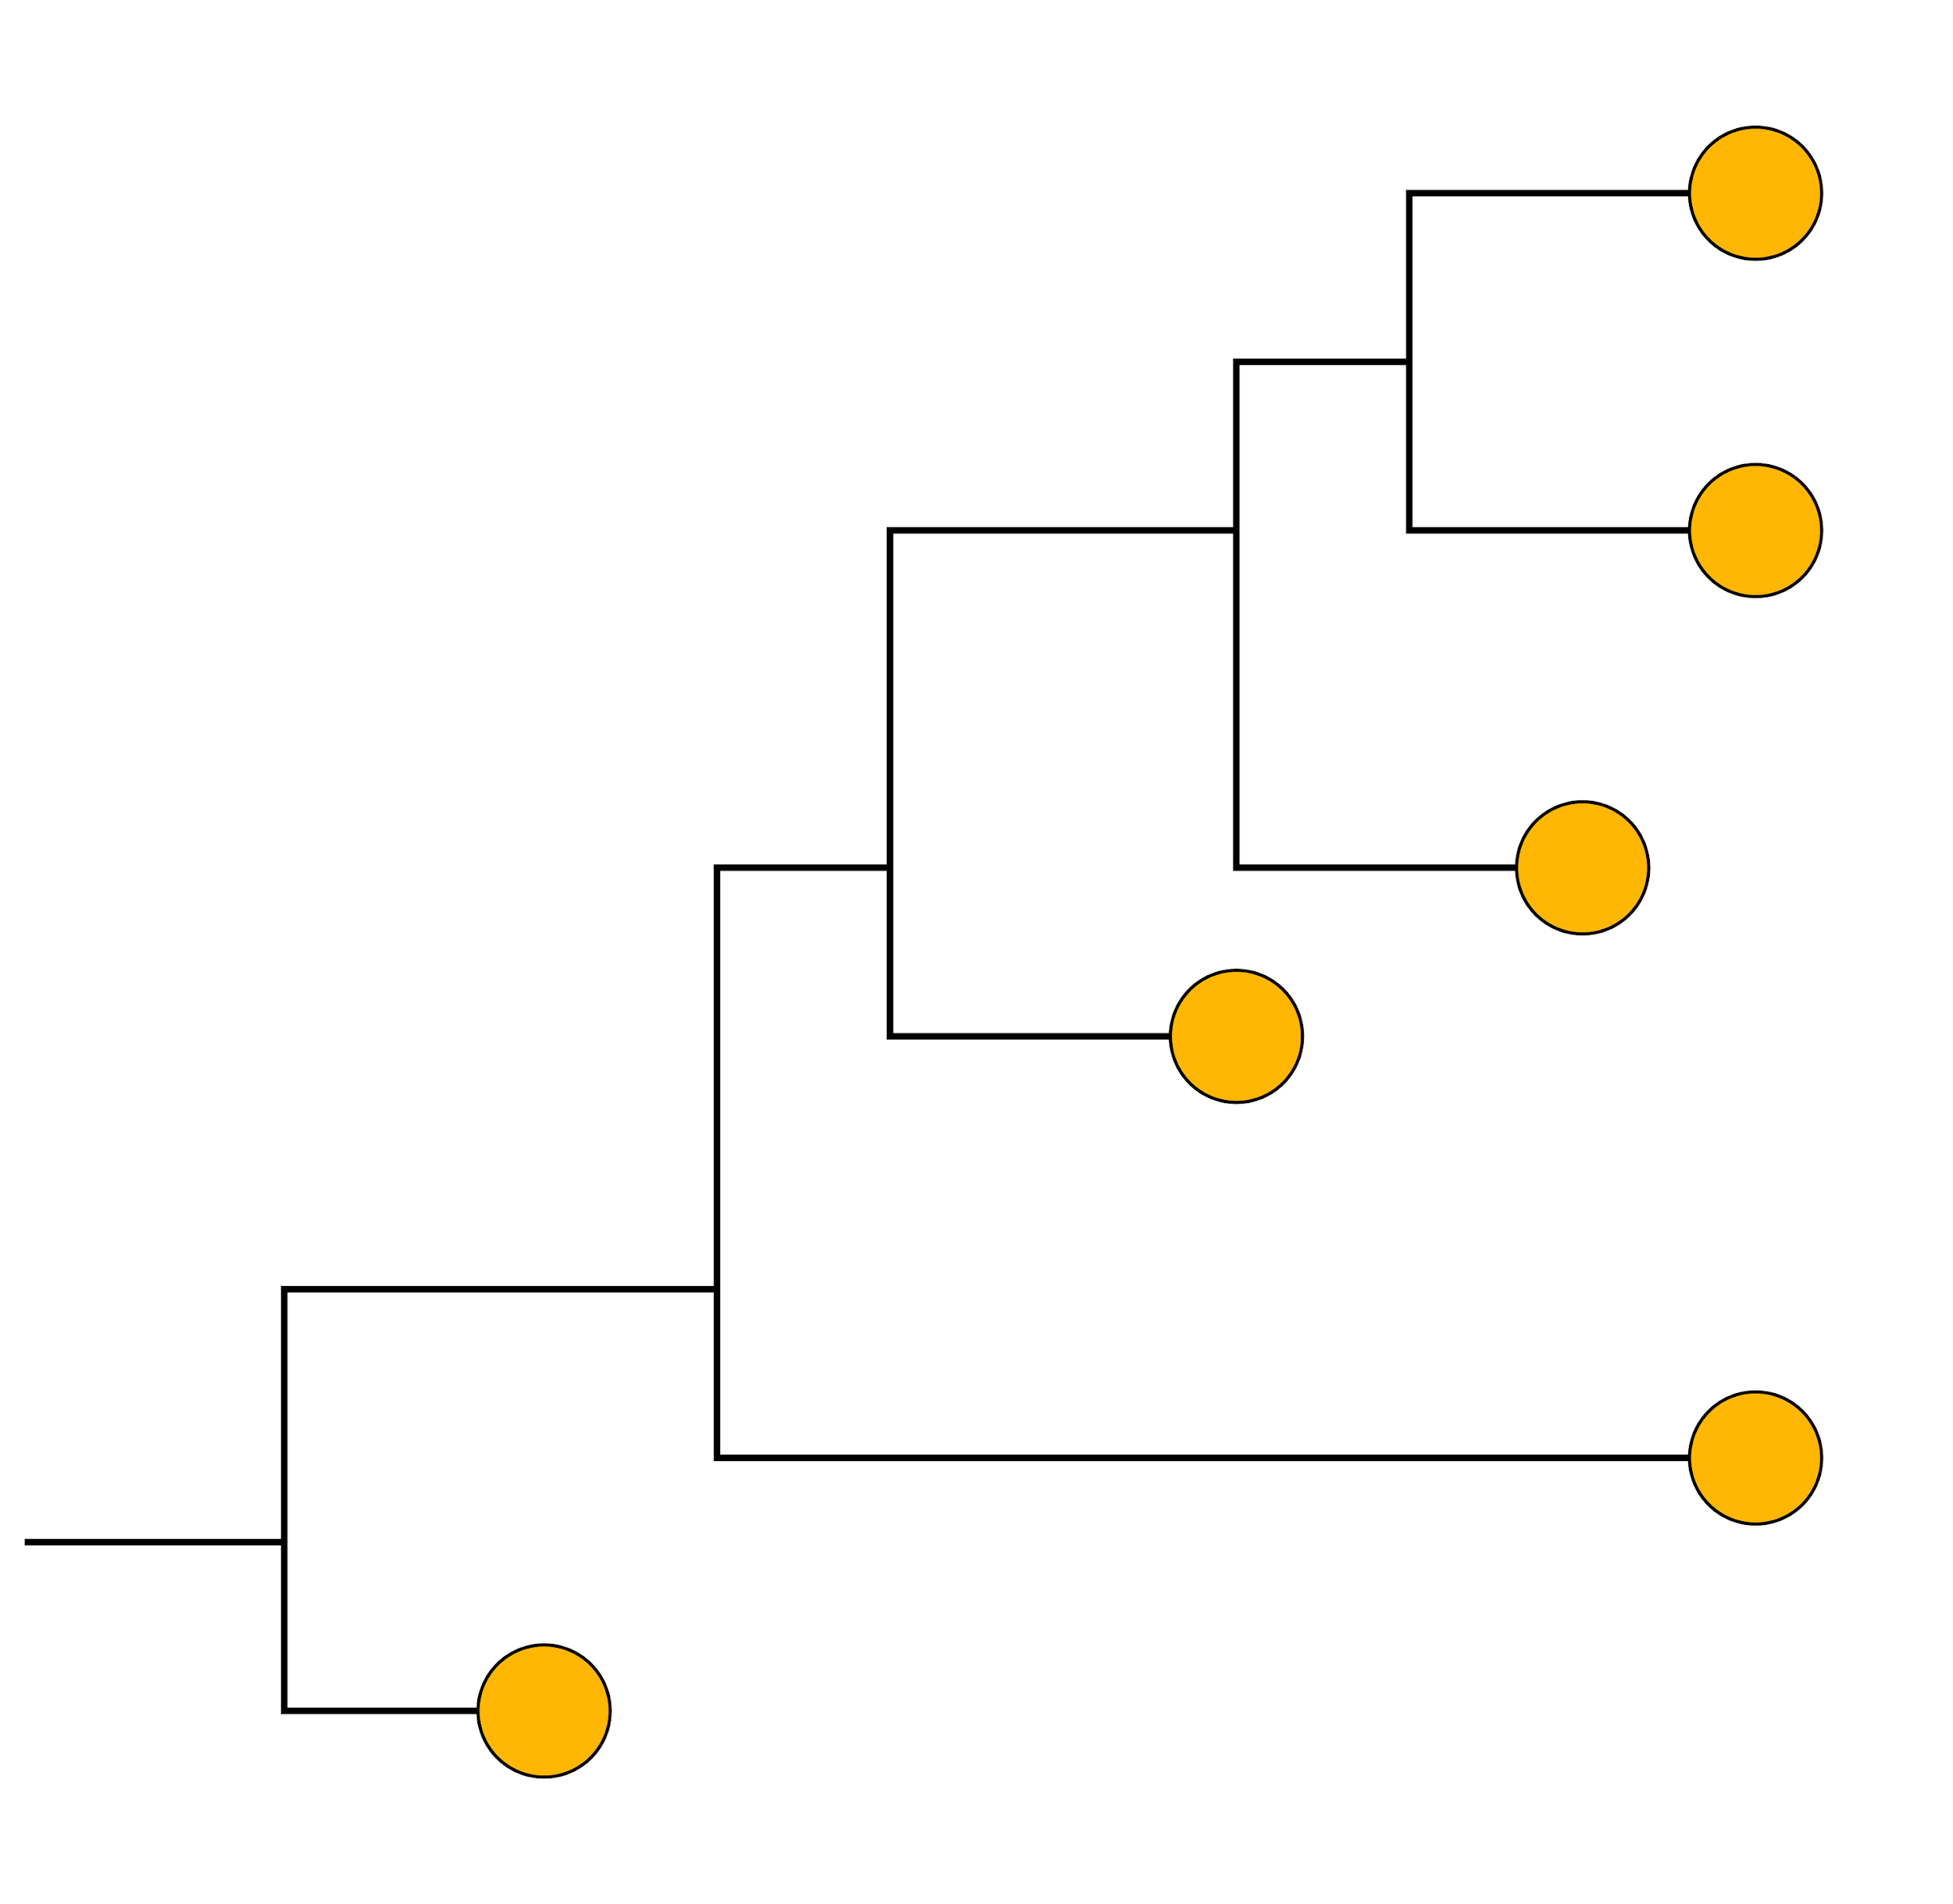




Evolutionary processes play out across multiple scales
Within hosts
Between hosts
Across space
Short term evolution
Longer term evolution
Time scale?
Notes:
Evolutionary processes happen at different scales
Across time, space, hosts (within and between hosts)

Slide 8
Evolutionary processes play out across multiple scales
Within hosts
Between hosts
Across space
Across time
2005
2005
2005
1995
1993
1990
Short term evolution
Longer term evolution
Time scale?
Time scale?
Notes:
Evolutionary processes happen at different scales
Across time, space, hosts (within and between hosts)

Slide 9
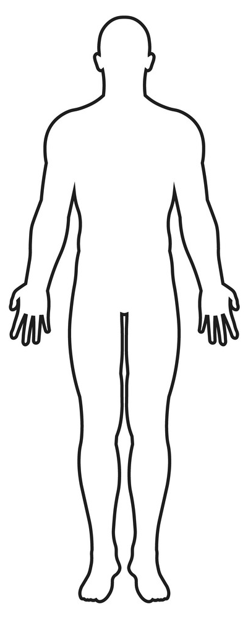


Within-host pathogen evolution
ATTTGC
ATTTGC
Random variation is generated during replication, often due to an error-prone polymerase
This process introduces mutations
CTTTGC
replication cycle 1
mutation: A > C
Notes:
As viruses replicate, mutational errors are incorporated into the viral genome.
The mutation rate is therefore typically expressed as the number of mutations per site, per replication event.
RNA-dependent RNA polymerase, which lacks proof-reading activity.
Feedback:

Slide 10

Within-host pathogen evolution
Mutation during replication generates diversity in within-host population
Mutations accumulate across multiple replication cycles
ATTTGC
ATTTGC
CTTTGC
AATTGC
ATTTAC
ATTCGC
TTTTTC
ATTCCC
CTTTGC
CCTTGC
CTTTAC
CTTTAC
CTTTGA
CTTTTC
ATTTGC
AATTGC
ATTTAC
ATTTGC
ATTCGC
ATTTGC
TTTTTC
ATTTGC
ATTCCC
CTTTGC
CTTTGC
CCTTGC
CTTTAC
CTTTAC
CTTTGA
CTTTTC
Time
Notes:
As viruses replicate, mutational errors are incorporated into the viral genome.
The mutation rate is therefore typically expressed as the number of mutations per site, per replication event.
RNA-dependent RNA polymerase, which lacks proof-reading activity.

Slide 11


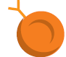
Selection acts on within-host diversity
ATTTGC
ATTTGC
CTTTGC
AATTGC
ATTTAC
ATTCGC
TTTTTC
ATTCCC
CTTTGC
CCTTGC
CTTTAC
CTTTAC
CTTTGA
CTTTTC
ATTTGC
ATTTGC
GTTTGC
AATTGC
ATTTAC
ATTCGC
TTTTTC
ATTCCC
CTTTGC
CCTTGC
CTTTTC
CTTTAC
CTTTGA
CTTTTC
Random variation generated by mutations
Selection pressure from immunity acts on diverse viral population
Notes:
CONFIRM COPYRIGHT FOR ALL IMAGES!
As viruses replicate, mutational errors are incorporated into the viral genome.
The mutation rate is therefore typically expressed as the number of mutations per site, per replication event.
RNA-dependent RNA polymerase, which lacks proof-reading activity.

Slide 12
Outline
Evolution across scales
Different types of mutations
Evolution within and between hosts

Slide 13
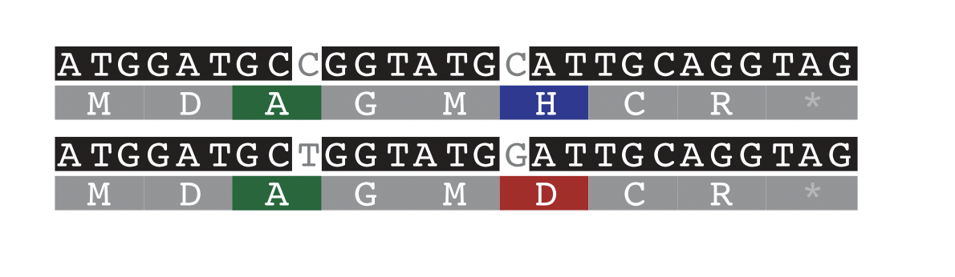
Types of mutations
Nucleotides
Sample 1
Amino acids
Sample 2
Notes:
Can we skip this slide?

Slide 14
Types of mutations
1. Synonymous (‘S’) mutations
No change on protein level
Mostly neutral
Nucleotides
Sample 1
Amino acids
Sample 2

Slide 15
Types of mutations
2. Non-synonymous (‘NS’) mutations
Change on protein level
Mostly deleterious
Can be adaptive
Nucleotides
Sample 1
Amino acids
Sample 2

Slide 16
Most mutations are deleterious
ATTTGC
AATTGC
ATTTAC
ATTTGC
ATTCGC
ATTTGC
TTTTTC
ATTTGC
ATTCCC
CTTTGC
CTTTGC
CCTTGC
CTTTAC
CTTTAC
CTTTGA
CTTTTC
Notes:
As viruses replicate, mutational errors are incorporated into the viral genome.
The mutation rate is therefore typically expressed as the number of mutations per site, per replication event.
RNA-dependent RNA polymerase, which lacks proof-reading activity.

Slide 17
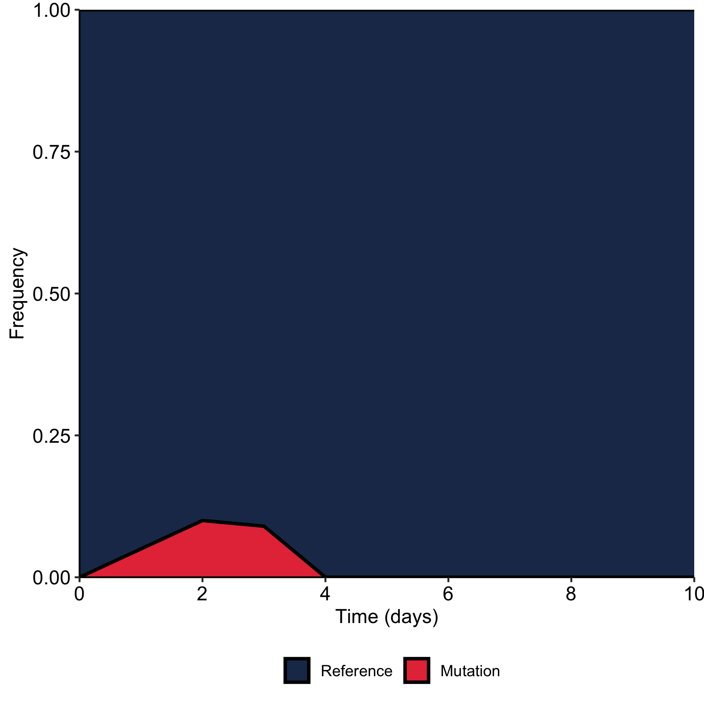
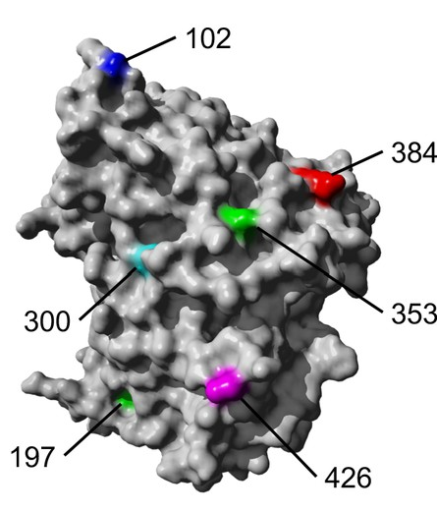
Most mutations are deleterious
Non-synonymous (‘NS’)
ATTTAC
Han et al. 2021
Notes:
CITATION FOR RIGHT IMAGE?
Most mutations are deleterious and will not grow to high frequency in population
As viruses replicate, mutational errors are incorporated into the viral genome.
The mutation rate is therefore typically expressed as the number of mutations per site, per replication event.
RNA-dependent RNA polymerase, which lacks proof-reading activity.
Feedback:

Slide 18
Some mutations are neutral
ATTTGC
ATTTGC
ATTCGC
ATTTGC
TTTTTC
ATTTGC
CTTTGC
CCTTGC
CTTTAC
Notes:
As viruses replicate, mutational errors are incorporated into the viral genome.
The mutation rate is therefore typically expressed as the number of mutations per site, per replication event.
RNA-dependent RNA polymerase, which lacks proof-reading activity.

Slide 19
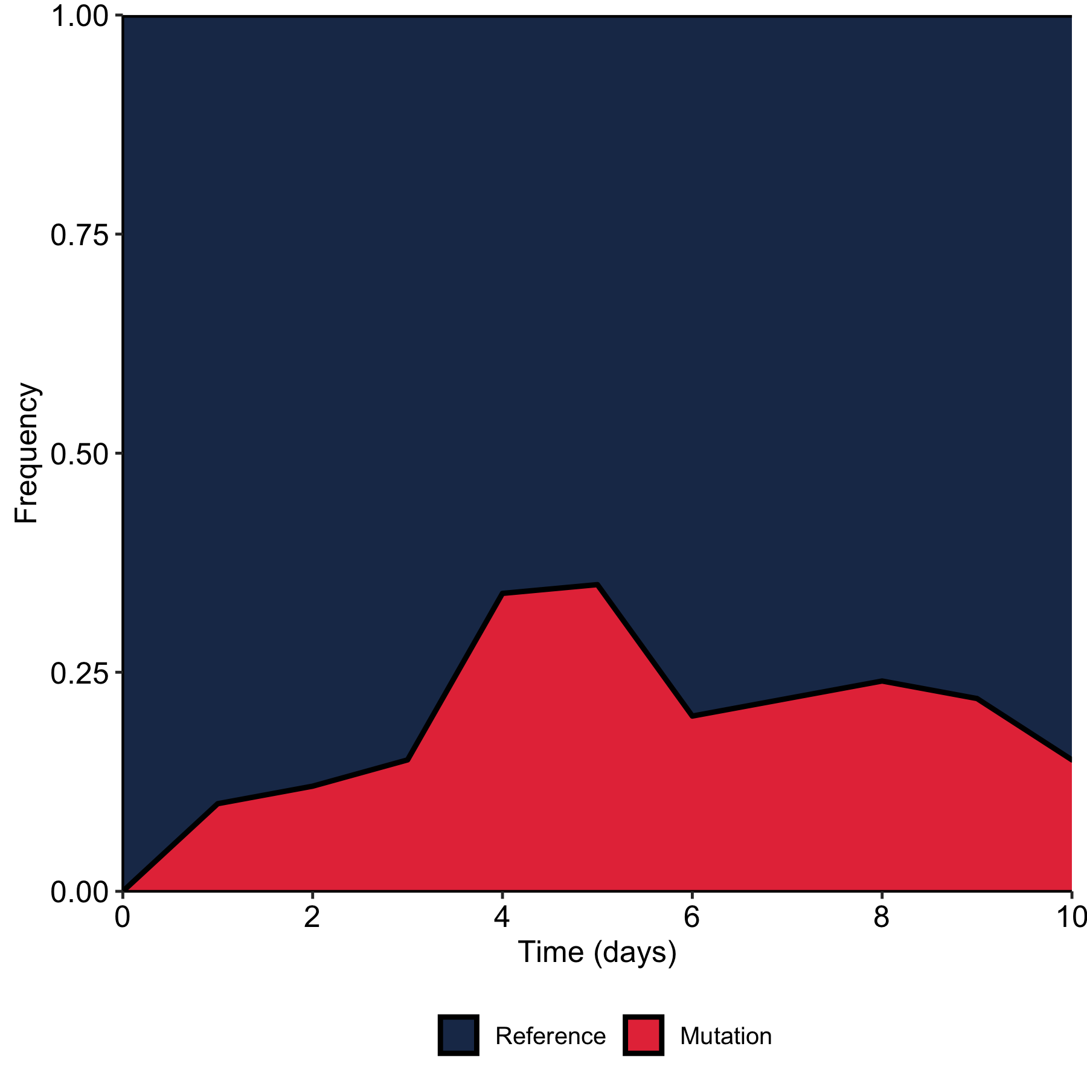
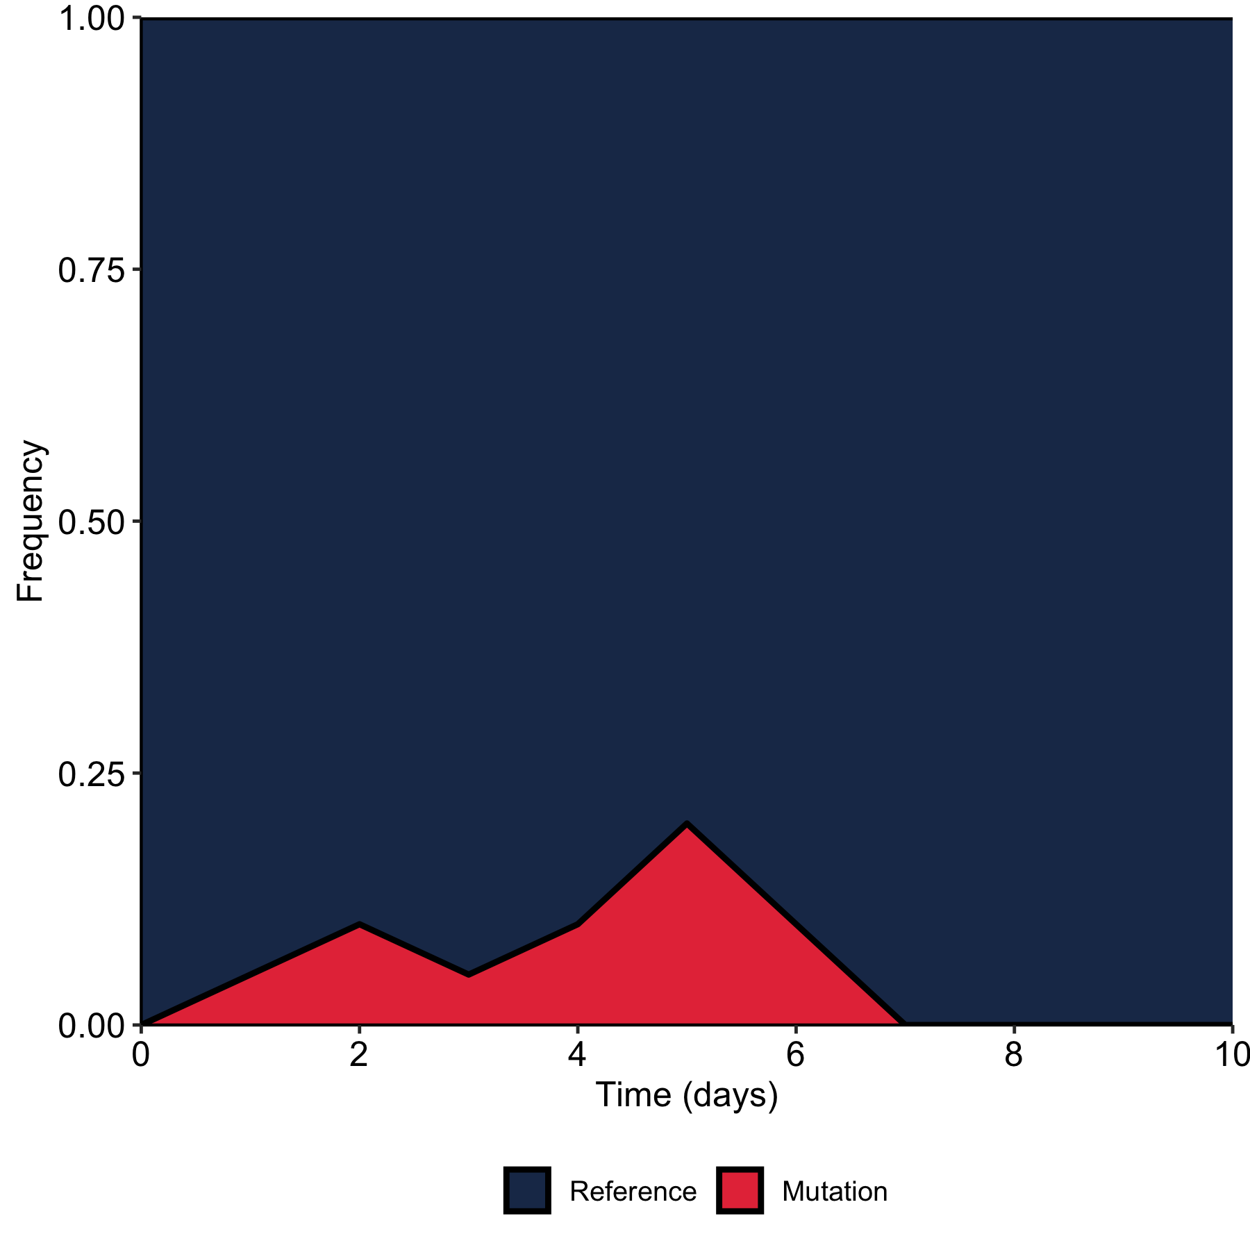
Some mutations are neutral
Synonymous (‘S’)
ATTCGC
CCTTGC
Notes:
Some mutations are neutral and will randomly fluctuate in frequency in the population
As viruses replicate, mutational errors are incorporated into the viral genome.
The mutation rate is therefore typically expressed as the number of mutations per site, per replication event.
RNA-dependent RNA polymerase, which lacks proof-reading activity.

Slide 20
Some mutations increase viral fitness
ATTTGC
ATTTGC
ATTCGC
ATTTGC
TTTTTC
ATTTGC
CTTTGC
CCTTGC
CTTTAC
Notes:
As viruses replicate, mutational errors are incorporated into the viral genome.
The mutation rate is therefore typically expressed as the number of mutations per site, per replication event.
RNA-dependent RNA polymerase, which lacks proof-reading activity.
Feedback:

Slide 21
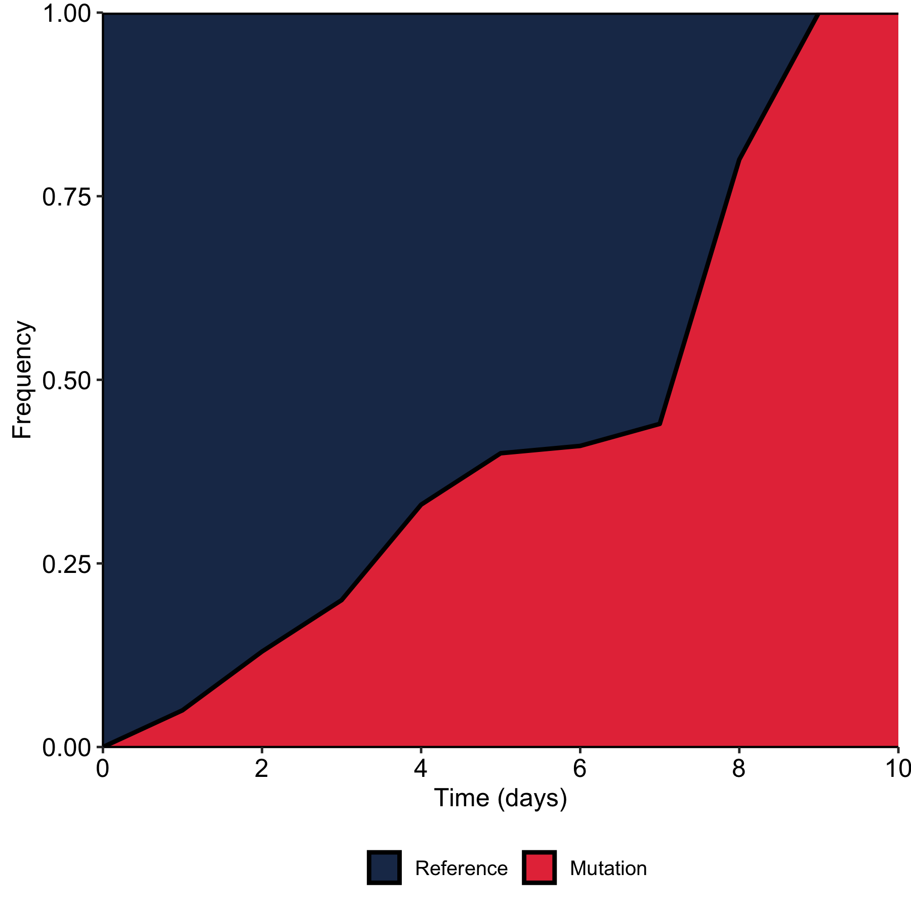
Some mutations increase viral fitness
CCTTGC
Han et al. 2021
Notes:
Some mutations increase viral fitness through e.g. immune escape and will grow in frequency in the population
As viruses replicate, mutational errors are incorporated into the viral genome.
The mutation rate is therefore typically expressed as the number of mutations per site, per replication event.
RNA-dependent RNA polymerase, which lacks proof-reading activity.
Feedback:
Word missing in title?

Slide 22
What do we mean by fitness advantage?
Fitness on what scale?
Transmission?
Replication?
Immune evasion?
Survival in water?
Interaction of these scales?
Notes:
Immune escape, transmission fitness, or both?

Slide 23
Outline
Evolution across scales
Different types of mutations
Evolution within and between hosts

Slide 24
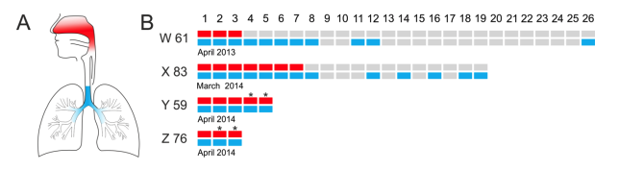
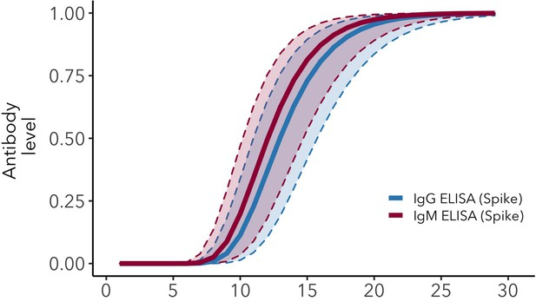
Many processes shape viral diversity within host
Many factors at play
When does recall immunity start?
Compartmentalization of the viral diversity by chance
ATTTGC
ATTTGC
GTTTGC
AATTGC
ATTTAC
ATTCGC
TTTTTC
ATTCCC
CTTTGC
CCTTGC
CTTTTC
CTTTAC
CTTTGA
CTTTTC
Days post symptom onset
Borremans et al. 2020
Koel et al. 2020
Notes:
As viruses replicate, mutational errors are incorporated into the viral genome.
The mutation rate is therefore typically expressed as the number of mutations per site, per replication event.
RNA-dependent RNA polymerase, which lacks proof-reading activity.

Slide 25
Many processes shape viral diversity between hosts
Inter-host bottleneck
Secretion bottleneck
Morris et al. 2020
Notes:
Feedback:
More descriptive title?
Why citing figure now and not before? Perhaps we can make a non-copyright version of this for you to use throughout (ask Shirlee)

Slide 26
Many processes shape viral diversity between hosts
Inter-host bottleneck
Mucus bottleneck
Mucosal immunity bottleneck
Cell infection bottleneck
Secretion bottleneck
Morris et al. 2020

Slide 27
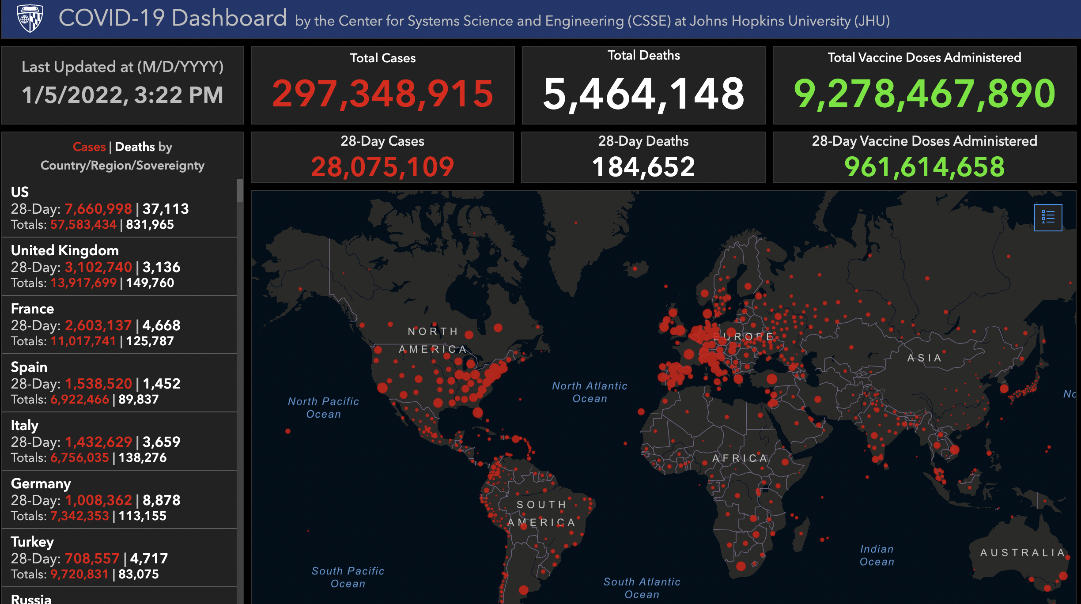
Evolution plays out across global populations
Morris et al. 2020
Notes:
Feedback:
Larger/not distorted figures!

Slide 28
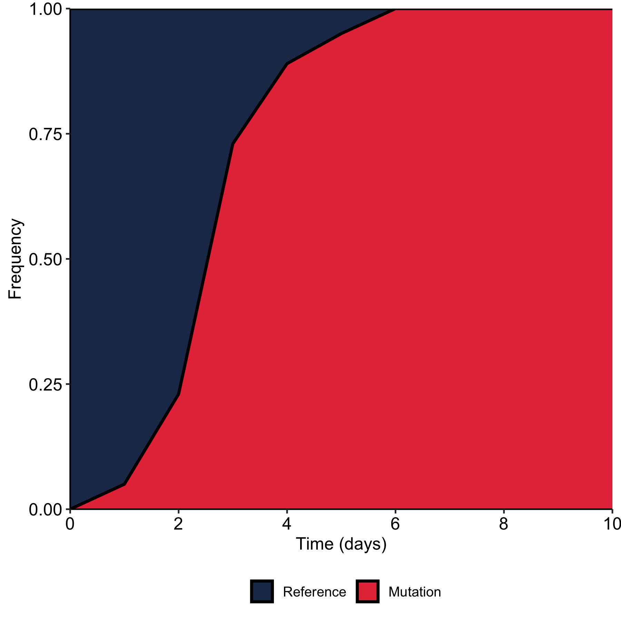
What is the selection regime?
Positive or adaptive selection selects mutations that confer fitness advantages
Negative or purifying selection acts to eliminate deleterious mutations

Slide 29
What is the strength of selection?
Weak?
Strong?
Time-dependent?

Slide 30
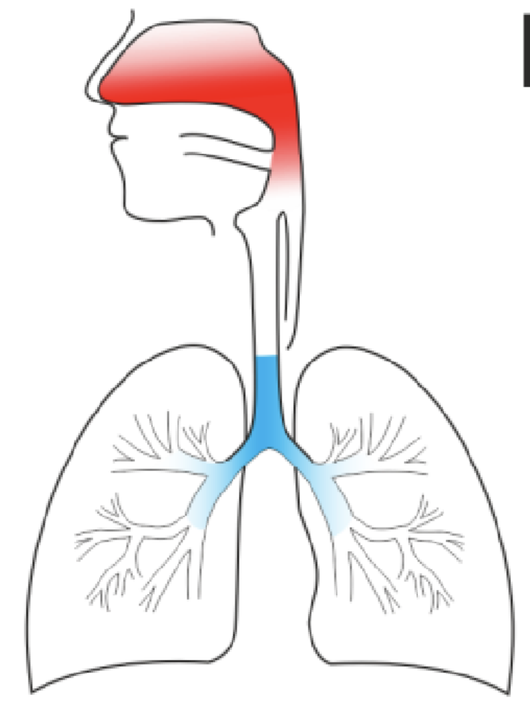
When and where does selection apply?
Upper respiratory tract?
Lower respiratory tract?
Days post symptom onset
Borremans et al. 2020.
Koel et al. 2020.
Notes:
LUNG FIGURE IS BLURRY – NEED HIGH RES VERSION!

Slide 31
Summary
Viruses evolve across many scales
Random variation is generated within host
Mutations can be silent or non-silent
Selection shapes diversity within host
Selection and randomness shapes diversity during spread between hosts

